Slide 1


Distributed data in Django services
Pavel Lonkin, Team Leader

Slide 2




Hi, there!
https://www.linkedin.com/in/plonkin
@pavel_lonkin
@d3rky
Pavel “Pasha” Lonkin

Slide 3
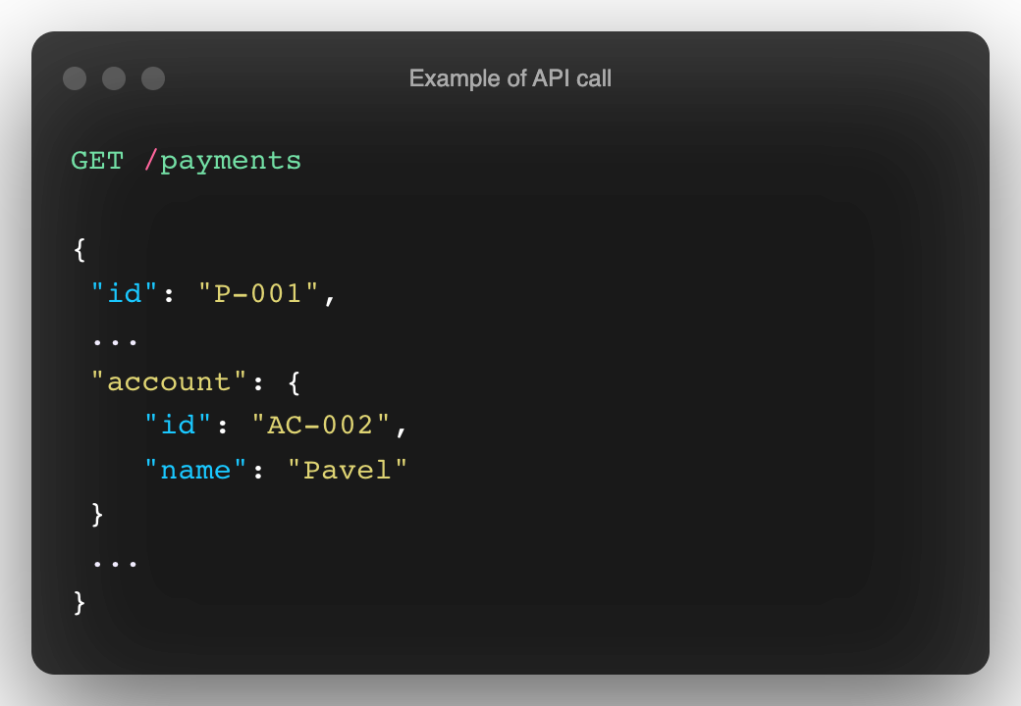

What’s the problem?
Monolith
Payments
Taxes
Contracts
Accounts
Orders
Notes:
Monoliths are perfect, they are simple, they are just doing their job, no additional complexity… But till… you have PoC or the load is not significant or the development team is small
Questions:
Who is using the microservices architecture?
Who tried to Split the monolith?
Who is in the process of splititng the monolith?

Slide 4
What’s the problem?
Services
Payments
Taxes
Contracts
Accounts
Orders
How to break the “ice”?
How to join data then?
Notes:
The most correct way to do the microservices – to use separate DBs for each of them. But it opens the Good question, what to do with relations between Domain entities?

Slide 5
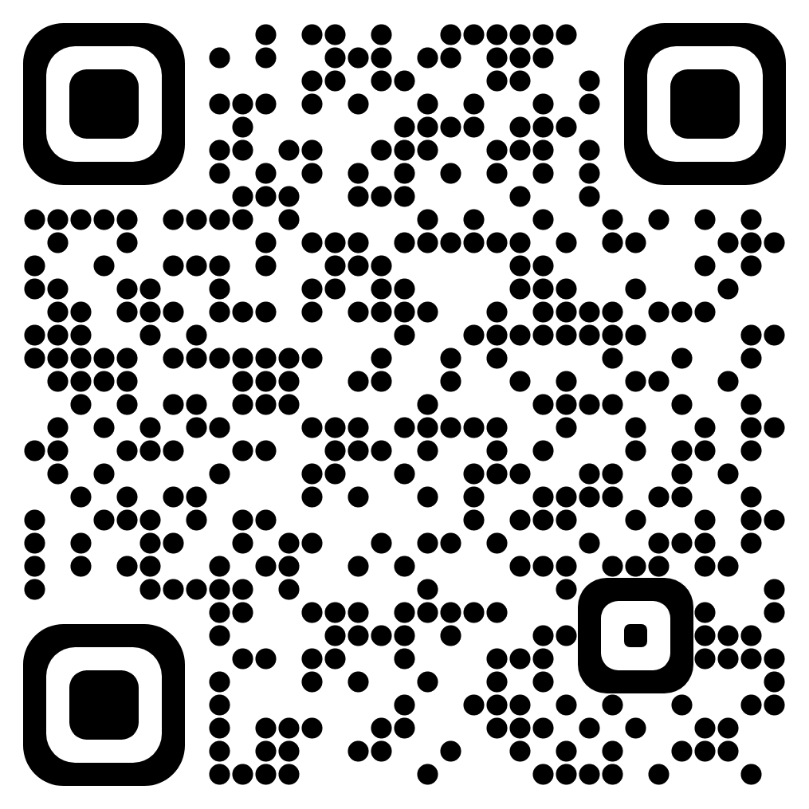
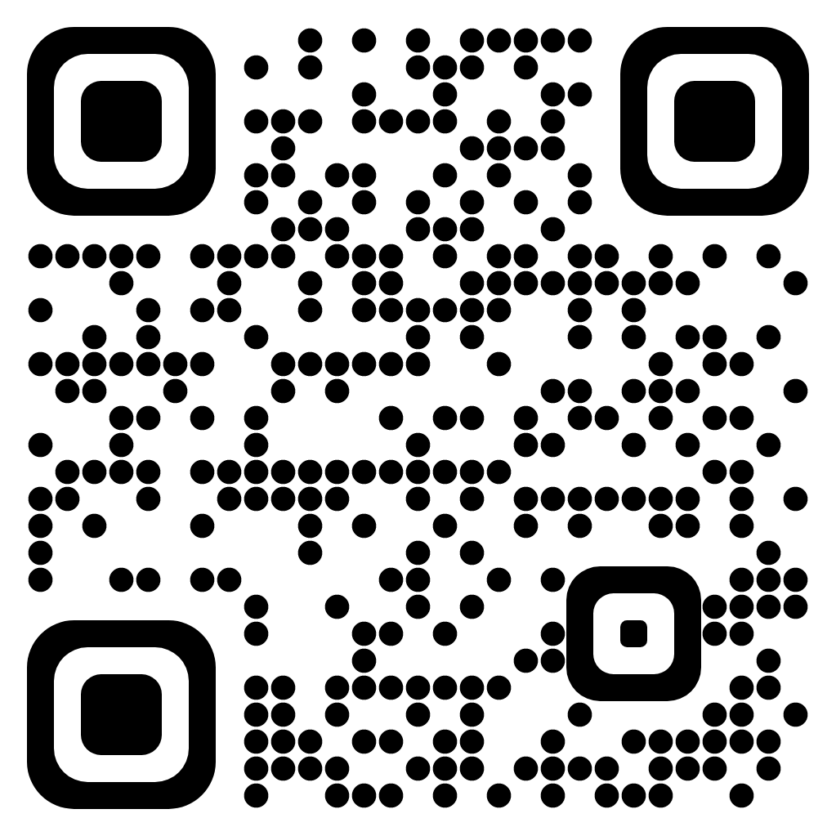
How to break the ”ice”?
API Composition
CQRS
(Command Query Responsibility Segregation)
https://microservices.io/patterns/data/api-composition.html
https://microservices.io/patterns/data/cqrs.html

Slide 6
API Composition
Accounts
Payments
Contracts
Orders

Slide 7
API Composition
GET /payments?account.name=Pavel
Accounts
Payments
Contracts
Orders

Slide 8
API Composition
GET /payments?account.name=Pavel
API Composer
Accounts
Payments
Contracts
Orders

Slide 9

API Composition
GET /payments?account.name=Pavel
API Composer
Inefficient
Query 4
Query 1
In-memory joins of large data sets
Accounts
Query 3
Query 2
Payments
Contracts
Orders

Slide 10
CQRS (Command Query Responsibility Segregation)
GET /payments?account.name=Pavel
Payments
Accounts
Contracts
Orders

Slide 11
CQRS (Command Query Responsibility Segregation)
GET /payments?account.name=Pavel
Payments
Message Broker
Accounts
Contracts
Orders

Slide 12

CQRS (Command Query Responsibility Segregation)
GET /payments?account.name=Pavel
Query
Payments
Ok, Pasha, that’s cool.
But where are queries and commands?
Event handlers
Message Broker
Event
Event
Event
Accounts
Contracts
Orders
POST /accounts
PUT /contracts/1
DELETE /orders/1
Commands
Notes:
Ask about the commands and queries? What they are?
And where they are in the diagram?

Slide 13

CQRS (Command Query Responsibility Segregation)
GET /payments?account.name=Pavel
Payments
Only needed data is on the destination side
Event handlers
Low coherence
Message Broker
Guaranteed consistency
Replication lag or eventual consistency
Code & data duplication
Accounts
Contracts
Orders
Notes:
Ask audience: what is eventual consistency?

Slide 14
API Composition
CQRS
(Command Query Responsibility Segregation)
Only needed data is on the destination side
Low coherence
Guaranteed consistency
Inefficient
Replication lag or eventual consistency
In-memory joins of large data sets
Code & data duplication

Slide 15




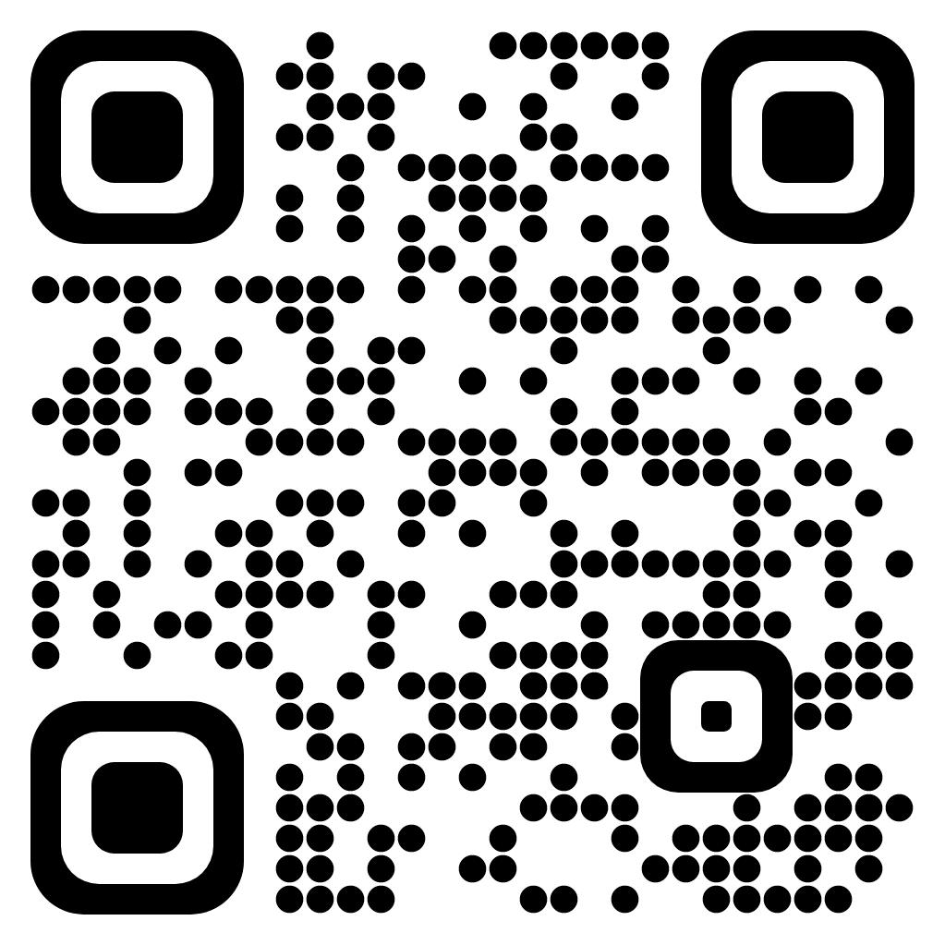
What did we have at that moment?
We were young and full of energy
Django
Different databases (MySQL, Postgres)
Nothing reasonable for CQRS pattern in Django
But…
Maxim Kolyubyakin
We have a Team and Max!

Slide 16
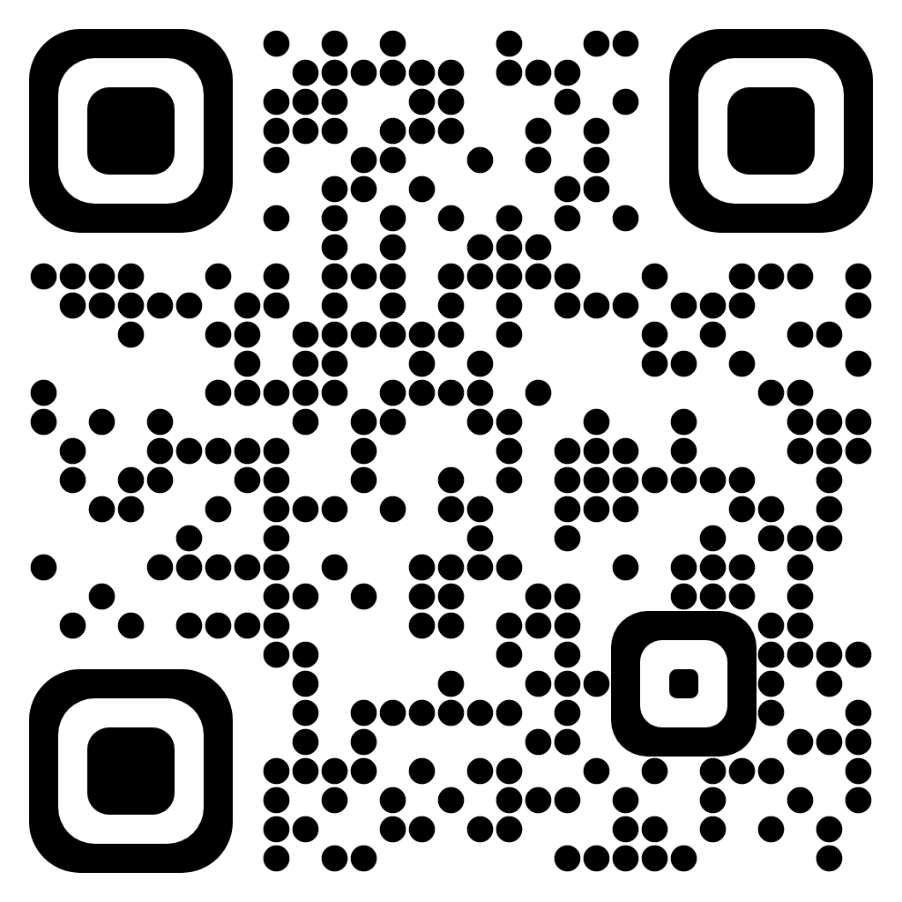
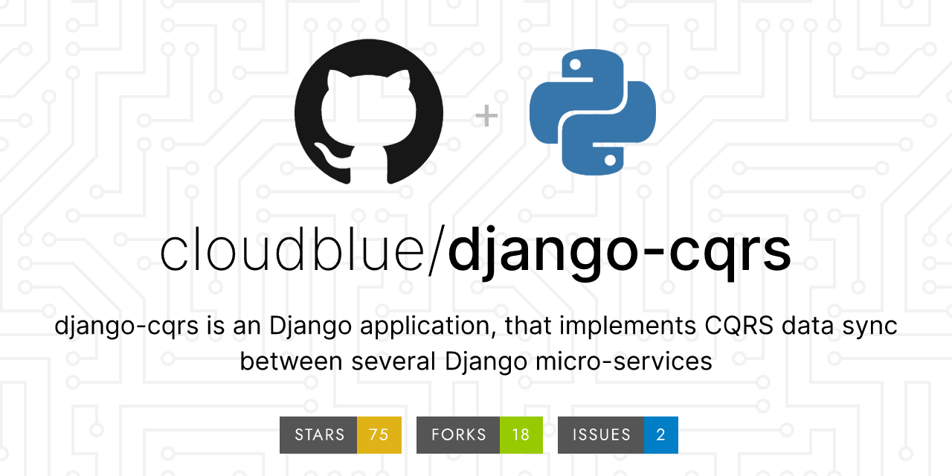
Django CQRS

Slide 17
Master
Replicas
Payments
Accounts
Model 1
Message Broker
Contracts
Model 2
Model 3
Orders

Slide 18
Key Features
You need 5 steps to run it
in your Django app
Master
Replicas
Payments
You don’t need to dramatically
change your code
Accounts
Contracts
Supports different databases
from out of the box
Orders
Production ready

Slide 19
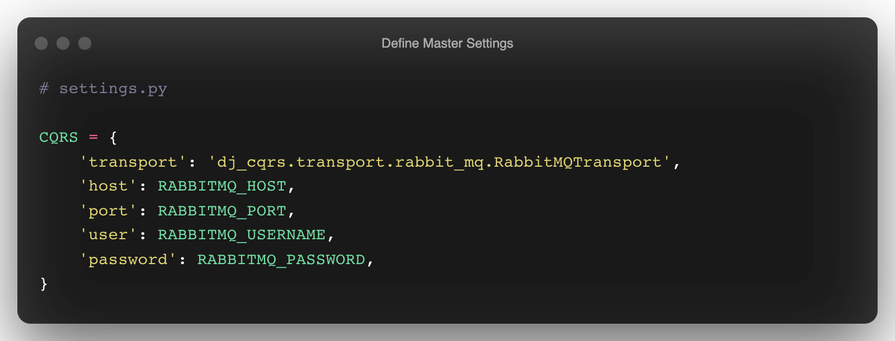
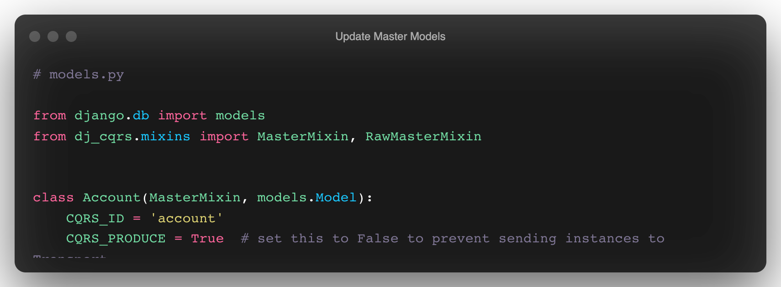
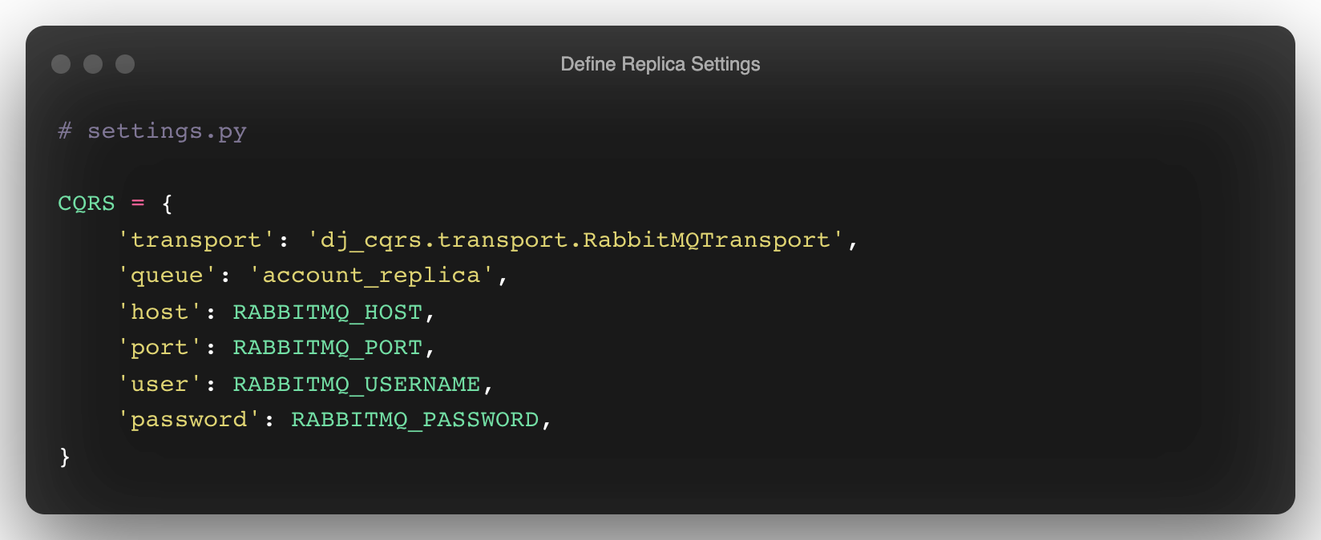
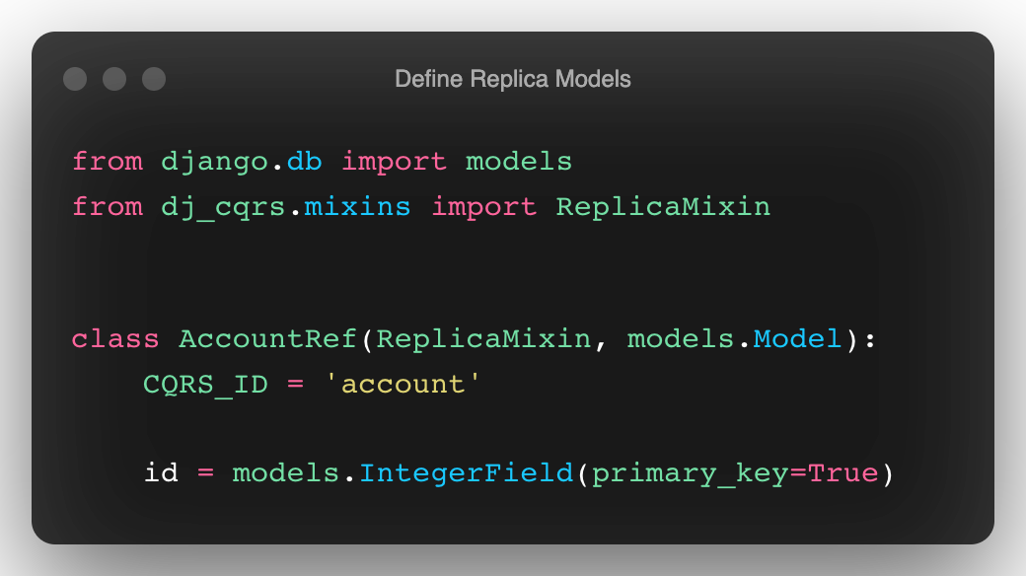
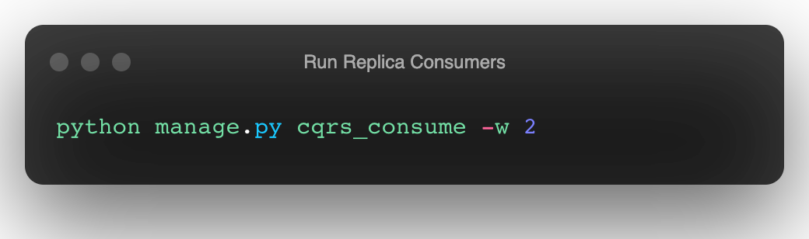
5 steps to run Django CQRS
1. Define Master Settings
2. Update Master Models
3. Define Replica Settings
4. Define Replica Models
5. Run Replica Consumers

Slide 20
5 steps to run Django CQRS
Demote
2. Update Master Models
3. Define Replica Settings
4. Define Replica Models
5. Run Replica Consumers

Slide 21
5 steps to run Django CQRS
1. Define Master Settings
2. Update Master Models
3. Define Replica Settings
4. Define Replica Models
5. Run Replica Consumers

Slide 22
5 steps to run Django CQRS
Demote
1. Define Master Settings
3. Define Replica Settings
4. Define Replica Models
5. Run Replica Consumers

Slide 23
5 steps to run Django CQRS
1. Define Master Settings
2. Update Master Models
3. Define Replica Settings
4. Define Replica Models
5. Run Replica Consumers

Slide 24
5 steps to run Django CQRS
Demote
1. Define Master Settings
2. Update Master Models
4. Define Replica Models
5. Run Replica Consumers

Slide 25
5 steps to run Django CQRS
1. Define Master Settings
2. Update Master Models
3. Define Replica Settings
4. Define Replica Models
5. Run Replica Consumers

Slide 26
5 steps to run Django CQRS
Demote
1. Define Master Settings
2. Update Master Models
3. Define Replica Settings
5. Run Replica Consumers

Slide 27
5 steps to run Django CQRS
1. Define Master Settings
2. Update Master Models
3. Define Replica Settings
4. Define Replica Models
5. Run Replica Consumers

Slide 28
5 steps to run Django CQRS
Demote
1. Define Master Settings
2. Update Master Models
3. Define Replica Settings
4. Define Replica Models

Slide 29
5 steps to run Django CQRS
1. Define Master Settings
2. Update Master Models
3. Define Replica Settings
4. Define Replica Models
5. Run Replica Consumers

Slide 30
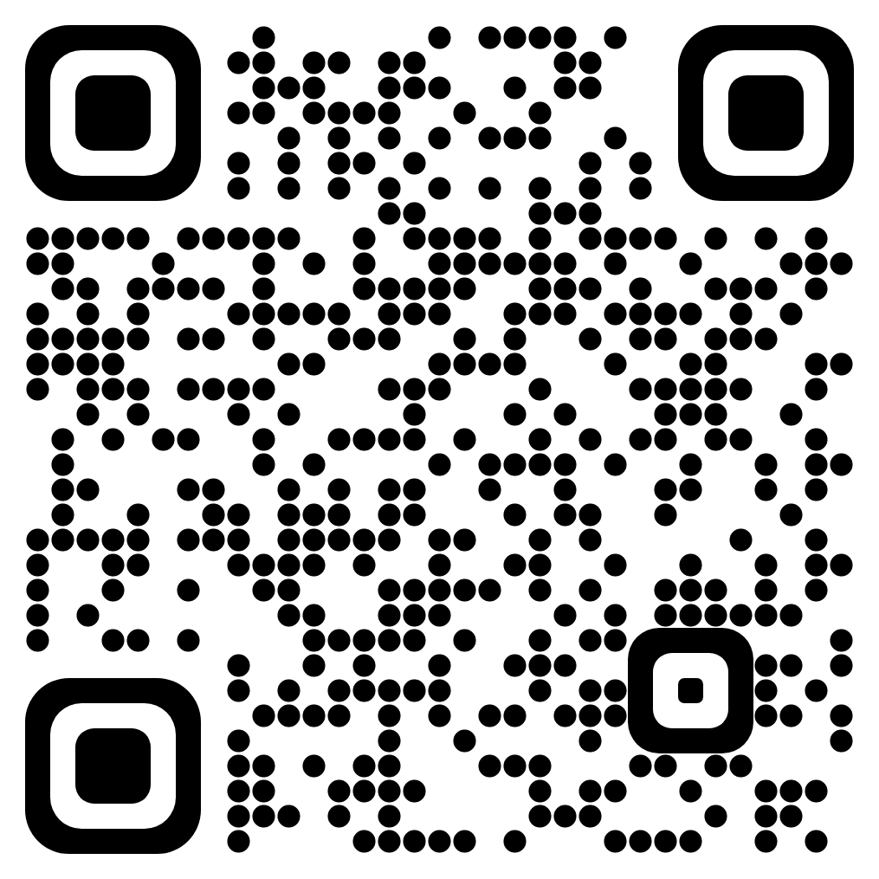
5 steps to run Django CQRS
Demote
1. Define Master Settings
2. Update Master Models
3. Define Replica Settings
4. Define Replica Models
5. Run Replica Consumers
Demo example

Slide 31
Other Features
Retry and Dead Letters Queues
Administration tools to sync, check diff between master and replicas, etc
Support of multiple transports (you can use your own)

Slide 32
Bonus! Zero downtime data migrations
Monolith
Payments
Taxes
Contracts
Accounts
Orders

Slide 33
Bonus! Zero downtime data migrations
Monolith
Payments
Taxes
Contracts
Accounts
Orders

Slide 34
Bonus! Zero downtime data migrations
Monolith
Service
Payments
Taxes
Master
Payments
Replica
Taxes
Replica
Contracts
Accounts
Orders
Orders
Replica

Slide 35
Bonus! Zero downtime data migrations
Monolith
Service
Payments
Payments
Replica
Taxes
Contracts
Accounts
Orders
Orders
Replica

Slide 36
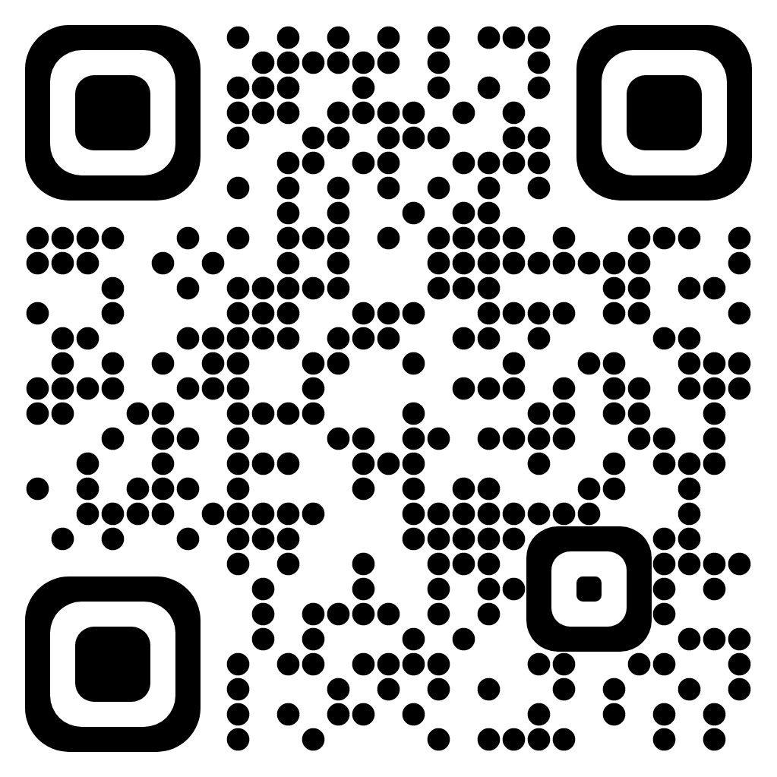
Careers
https://www.cloudblue.com/company/careers/
https://www.linkedin.com/in/plonkin
@pavel_lonkin
@d3rky

